Slide 1
Data Structure Using C
Dr. Nachiket Tapas

Slide 2
Scheme
Course Subject | Course Code | End Semester Exam | Class Test | Teacher Assessment
Data Structure Using C | A000272 (022) | 100 | 20 | 20
Data Structure Using C Lab | A000291 (022) | 40 | - | 20

Slide 3
Exams
There can be surprise quizzes during the lectures.
There will be an End Semester Exam (ESE) for 100 Marks.
There will be two class tests before the ESE each for 20 marks.

Slide 4
Syllabus
FUNDAMENTAL CONCEPTS
Introduction to Data Structures: Data, Data Objects, Data Types ,Abstract Data Type (ADT) and data structures, Concepts of static and dynamic, linear and nonlinear data structures.
Introduction to Algorithms: Definition and Characteristics of an algorithm. Algorithm design tools – flowcharts and pseudo code, notations – algorithm header, purpose, conditions and selection, loops, procedures and sub-algorithms.
Program development: Analysis, Design, Coding, Testing and Verification.

Slide 5
Contd.
LINEAR DATA STRUCTURES USING SEQUENTIAL ORGANIZATION, SEARCHING AND SORTING
Concept of sequential organization, arrays as ADT, Storage representation of array, Matrix operations using arrays,
String operations (Length, Concatenation, Copy, Palindrome, Reverse, Compare, Substring) without using library functions,
Searching: linear and binary search algorithms.
Sorting: General concepts–Bubble sort, Insertion sort, Selection sort, Heap sort, Merge sort, Quick sort.

Slide 6
Contd.
ALGORITHM ANALYSIS AND ALGORITHM DESIGN STRATEGIES
Algorithm Analysis: Time Complexity–Bigoh ‘O’, Omega ‘Ω’, Theta ‘θ’,
Best, Average and Worst case analysis: binary search, quick sort, merge sort, insertion sort.
Algorithmic Strategies: Divide and Conquer (quick sort and Tower of Hanoi),Backtracking(n-queens problem), greedy (job scheduling), dynamic programming, branch and bound.

Slide 7
Contd.
LISTS
List as ADT, Concept of linked organization of data against linked list.
Singly linked list, doubly linked list, circular linked list.
Representation & manipulations of polynomials/sets using linked lists.
Dynamic memory management. Representation of sparse matrix. Addition and transpose of sparse matrix

Slide 8
Contd.
STACKS AND QUEUES
Stack and queue as ADT. Operations on stack and queue. Implementations using arrays and dynamic memory allocation. Application of stack for expression evaluation, expression conversion. Recursion and stacks

Slide 9
Contd.
TREES AND GRAPHS
Basic terminology. Binary trees and its representation. Binary tree traversals (recursive and non-recursive) and various operations. Insertion and deletion of nodes in binary search tree.
Representation of graphs using adjacency matrix, adjacency list. Implementation of algorithms for traversals; implementing Kruskal's, Prim's algorithms. Single source shortest paths using Dijkstra’s algorithm.
Applications of graphs and trees.

Slide 10
Labs
In each lab you will be given few problems to solve
You need to prepare the practical file with solution to problems.
You must work on your own.
Discussion is allowed, but sharing of code in any form is NOT permitted.

Slide 11
Textbooks
Y. Langsam, M. Augenstin and A. Tannenbaum, “Data Structures using C”, Pearson Education Asia, First Edition, 2002, ISBN 978-81-317-0229-1.
E.Horowitz, S.Sahni, S.Anderson Freed,“Fundamentals of Data Structures in C”,Second Edition, University Press, ISBN 978-81-7371-605-8
C, Prentice Hall of India, Second Edition, ISBN81-203-0596-5
Ellis Horowitz, S. Sahni, D. Mehta “Fundamentals of Data Structures in C++”, Galgotia Book Source, New Delhi.
Jean-Paul Tremblay, Paul. G. Soresan, “An introduction to data structures with Applications”, Tata Mc- Graw Hill International Editions, 2nd edition 1984,ISBN-0-07-462471-7.

Slide 12
Course Objective
To teach how to design a new user defined, efficient, data types array, stack, queue, list, tree, graph, etc. abstract data types and reusable code using object based design techniques.
To demonstrate good programming practices, coding standards, modular programming, procedural and object-based way of thinking.
To emphasize the design aspects of a new data structure for solving any real life problems.
To lay strong emphasis on time complexity analysis techniques and algorithm design techniques.

Slide 13
Let’s Begin

Slide 14
Algorithm
A formula or set of steps for solving a particular problem.
To be an algorithm, a set of rules must be unambiguous and have a clear stopping point.
Algorithm can be defined as: “A sequence of activities to be processed for getting desired output from a given input.”

Slide 15
Properties
Finiteness
Definiteness
Input
Output
Effectiveness

Slide 16
Finiteness
An algorithm must always terminate after a finite number of steps.
It means after every step one reaches closer to solution of the problem and after a finite number of steps algorithm reaches to the solution.

Slide 17
Definiteness
Each step of algorithm must be precisely defined.
Also the actions must be defined unambiguously for each activity in the algorithm.

Slide 18
Input
Any operation you perform need some beginning value/quantities associated with different activities in the operation.
So the value/quantities are given to the algorithm before it begins.

Slide 19
Output
One always expects output/result (expected value/quantities) in terms of output from an algorithm.
The result may be obtained at different stages of the algorithm.
If some result is from the intermediate stage of the operation then it is known as intermediate result and result obtained at the end of algorithm is known as end result.
The output is expected value/quantities always have a specified relation to the inputs.

Slide 20
Effectiveness
Algorithms to be developed/written using basic operations.
Actually operations should be basic, so that even they can in principle be done exactly and in a finite amount of time by a person, by using paper and pencil only.

Slide 21
Problem-1
Write an algorithm to print “Hello World”

Slide 22
Problem-1
Write an algorithm to print “Hello World”
Step 1: Start
Step 2: Print “Good Morning‟
Step 3: Stop

Slide 23
Problem-2
Write an algorithm to find area of a rectangle.

Slide 24
Problem-2
Write an algorithm to find area of a rectangle.
Step 1: Start
Step 2: Take length and breadth and
store them as L and B?
Step 3: Multiply by L and B and store it
in area
Step 4: Print area
Step 5: Stop

Slide 25
Problem 3
Write an algorithm to check whether she/he is eligible to vote? (more than or equal to 18 years old).

Slide 26
Problem 3
Write an algorithm to check whether she/he is eligible to vote? (more than or equal to 18 years old).
Step 1: Start
Step 2: Take age and store it in age
Step 3: Check age value, if age >= 18 then go to step 4 else step 5
Step 4: Print “Eligible to vote” and go to
step 6
Step 5: Print “Not eligible to vote”
Step 6: Stop

Slide 27
Problem 4
Write an algorithm to check whether given number is +ve, -ve or zero.

Slide 28
Problem 4
Write an algorithm to check whether given number is +ve, -ve or zero.
Step 1: Start
Step 2: Take any number and store it in n.
Step 3: Check n value, if n > 0 then go to
step 5 else go to step 4
Step 4: Check n value, if n < 0 then go to
step 6 else go to step 7
Step 5: Print “Given number is +ve”and go
to step 8
Step 6: Print “Given number is -ve” and go
to step 8
Step 7: Print “Given number is zero”
Step 8: Stop

Slide 29
Problem 5
Program to find the factorial of a number

Slide 30
Problem 5
Program to find the factorial of a number
Step 1: Start.
Step 2: Initialize variables.
Step 3: Check FOR condition.
Step 4: If the condition is true, then go to step 5 otherwise go to step 7.
Step 5: f = f * i.
Step 6: Go to step 3.
Step 7: Print value of factorial.
Step 8: Stop.

Slide 31
Algorithm vs Program vs Data Structure
An Algorithm is an outline, the essence of a computational procedure, step-by-step instructions.
A Program is an implementation of an algorithm in some programming language.
A Data Structure is an organization of data needed to solve the problem.

Slide 32
Example: Algorithm
matrixMultiply(A, B):
Assume dimension of A is (m x n), dimension of B is (p x q)
Begin
if n is not same as p, then exit
otherwise define C matrix as (m x q)
for i in range 0 to m - 1, do
for j in range 0 to q – 1, do
for k in range 0 to p, do
C[i, j] = C[i, j] + (A[i, k] * A[k, j])
done
done
done
End

Slide 33
Contd: Program
#include<stdio.h>
#include<stdlib.h>
int main(){
int a[10][10],b[10][10],mul[10][10],r,c,i,j,k;
// row and column input, Input matrix 1, Input matrix 2
for(i=0;i<r;i++)
{
for(j=0;j<c;j++)
{
mul[i][j]=0;
for(k=0;k<c;k++)
{
mul[i][j]+=a[i][k]*b[k][j];
}
}
}
// Remaining code
}

Slide 34
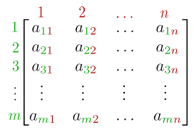
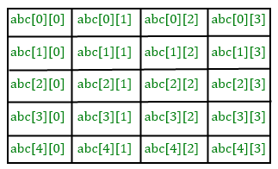
Data Structure
In the matrix multiplication problem, we used two dimensional array to represent the matrix. This makes the machine representation closer to the mathematical representation of the matrix.

Slide 35
Algorithmic Problem
There can be infinite number of input instances satisfying the specification.
Ex – You can select any random two matrices for multiplication. There dimensions can be different, their elements can be different.
Algorithm defines actions on the input instance.
Specification of Input
Algorithm
?
Specification of Output as function of Input

Slide 36
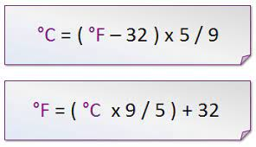
Algorithms in Ordinary Life?
An algorithm is a familiar concept: cooking recipes are almost algorithms! (not quite precise enough for a computer)
Write an algorithm for temperature conversion.

Slide 37
Algorithm
Start
Initialize F=0, C=0
Read C
F = (1.8*C) + 32
Print or display F
Stop
Start
Initialize F=0, C=0
Read F
C = (F-32) * 5 / 9.0
Print or display C
Stop

Slide 38
Problems
Write an algorithm that exchanges the value of two variables: x and y. The output must be: the value of variable y will become the value of variable x, and vice versa.
Design an algorithm to find the circumference of a circle. Use the formula: C=2πr, where π is approximately equivalent 3.1416.
Write an algorithm to compute the radius of a circle given the area. Derive your formula from the given equation: A=πr², then display the output.

Slide 39
Data vs Data Object vs Data Type
Data:
1,2,3,4...
a,b,c,d,...
A,B,C,D,...
...
int a; //Variable declaration
Data Object (int a)
name : a
address : 101101
data type: int

Slide 40
ADT (Abstract Data Type): What and Why?
Now there might be a situation when we need operations for our user-defined data type which have to be defined.
To simplify the process of solving problems, we can create data structures along with their operations, and such data structures that are not in-built are known as Abstract Data Type (ADT).
The definition of ADT only mentions what operations are to be performed but not how these operations will be implemented. It does not specify how data will be organized in memory and what algorithms will be used for implementing the operations. It is called “abstract” because it gives an implementation-independent view.

Slide 41
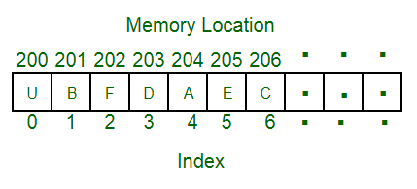
Array
An array is a collection of data items stored at contiguous memory locations.
The idea is to store multiple items of the same type together.
This makes it easier to calculate the position of each element by simply adding an offset to a base value, i.e., the memory location of the first element of the array (generally denoted by the name of the array).

Slide 42
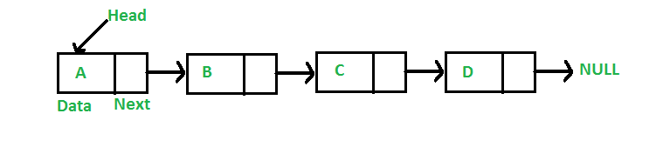
Linked List
Like arrays, Linked List is a linear data structure.
Unlike arrays, linked list elements are not stored at a contiguous location; the elements are linked using pointers.

Slide 43
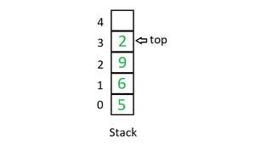
Stack
Stack is a linear data structure which follows a particular order in which the operations are performed.
The order may be LIFO(Last In First Out) or FILO(First In Last Out). In stack, all insertion and deletion are permitted at only one end of the list.

Slide 44
Operations
push() – Insert an element at one end of the stack called top.
pop() – Remove and return the element at the top of the stack, if it is not empty.
peek() or Top() – Return the element at the top of the stack without removing it, if the stack is not empty.
size() – Return the number of elements in the stack.
isEmpty() – Return true if the stack is empty, otherwise return false.
isFull() – Return true if the stack is full, otherwise return false.

Slide 45
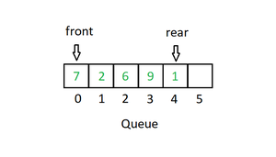
Queue
Like Stack, Queue is a linear structure which follows a particular order in which the operations are performed.
The order is First In First Out (FIFO).
In the queue, items are inserted at one end and deleted from the other end.
A good example of the queue is any queue of consumers for a resource where the consumer that came first is served first.

Slide 46
Operations
Enqueue: Adds an item to the queue. If the queue is full, then it is said to be an Overflow condition.
Dequeue: Removes an item from the queue. The items are popped in the same order in which they are pushed. If the queue is empty, then it is said to be an Underflow condition.
Front: Get the front item from the queue.
Rear: Get the last item from the queue.

Slide 47
Binary Tree
Unlike Arrays, Linked Lists, Stack and queues, which are linear data structures, trees are hierarchical data structures.
A binary tree is a tree data structure in which each node has at most two children, which are referred to as the left child and the right child.
It is implemented mainly using Links.
A Binary Tree is represented by a pointer to the topmost node in the tree. If the tree is empty, then the value of root is NULL.

Slide 48
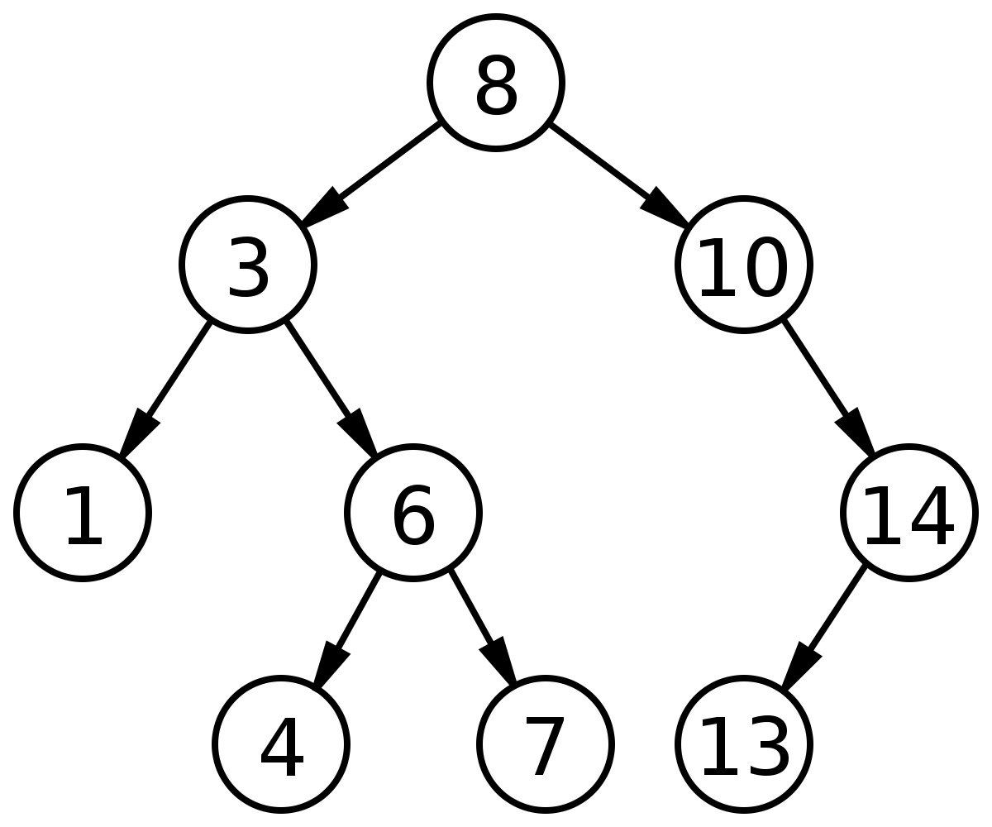
Binary Search Tree
In Binary Search Tree is a Binary Tree with the following additional properties:
The left subtree of a node contains only nodes with keys less than the node’s key.
The right subtree of a node contains only nodes with keys greater than the node’s key.
The left and right subtree each must also be a binary search tree.

Slide 49
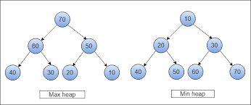
Heap
A Heap is a special Tree-based data structure in which the tree is a complete binary tree.
Generally, Heaps can be of two types:
Max-Heap: In a Max-Heap the key present at the root node must be greatest among the keys present at all of its children. The same property must be recursively true for all sub-trees in that Binary Tree.
Min-Heap: In a Min-Heap the key present at the root node must be minimum among the keys present at all of its children. The same property must be recursively true for all sub-trees in that Binary Tree.

Slide 50
Hashing Data Structure
Hashing is an important Data Structure which is designed to use a special function called the Hash function which is used to map a given value with a particular key for faster access of elements.
The efficiency of mapping depends on the efficiency of the hash function used.
Let a hash function H(x) maps the value x at the index x%10 in an Array. For example, if the list of values is [11, 12, 13, 14, 15] it will be stored at positions {1, 2, 3, 4, 5} in the array or Hash table respectively.

Slide 51
Trie
Trie is an efficient information reTrieval data structure.
Using Trie, search complexities can be brought to an optimal limit (key length).
Why?
With Trie, we can insert and find strings in O(L) time where L represent the length of a single word. This is obviously faster than BST. This is also faster than Hashing because of the ways it is implemented. We do not need to compute any hash function. No collision handling is required (like we do in open addressing and separate chaining)
Another advantage of Trie is, we can easily print all words in alphabetical order which is not easily possible with hashing.
We can efficiently do prefix search (or auto-complete) with Trie.

Slide 52
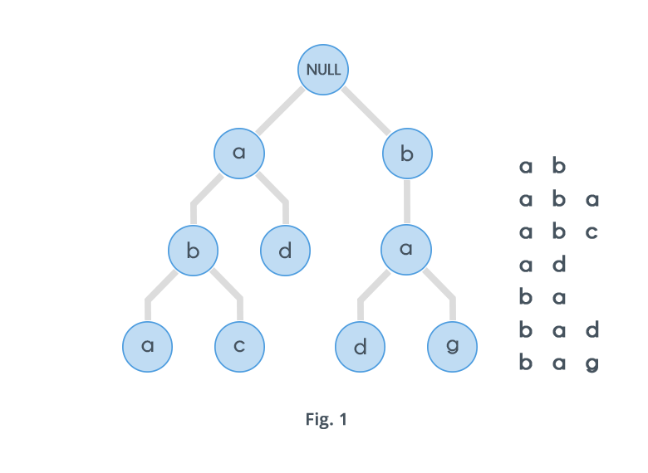
Example

Slide 53
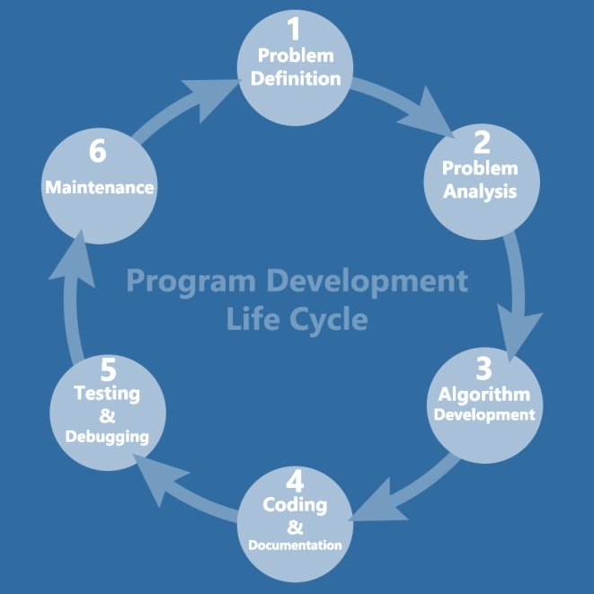
Phases of program development
Problem Definition.
Problem Analysis.
Algorithm Development.
Coding & Documentation.
Testing & Debugging.
Maintenance.

Slide 54
Problem Definition
Here, we define the problem statement and decide the boundaries of the problem.
In this phase, we need to understand what is the problem statement, what is our requirement and what is the output of the problem solution.
All these are included in the first phase of program development life cycle.

Slide 55
Problem Analysis
Here, we determine the requirements like variables, functions, etc. to solve the problem.
It means that we gather the required resources to solve the problem, which are defined in the problem definition phase.
Here, we also determine the bounds of the solution.

Slide 56
Algorithm Development
Here, we develop a step-by-step procedure that is used to solve the problem by using the specification given in the previous phase.
It is very important phase for the program development.
We write the solution in step-by-step statements.

Slide 57
Coding & Documentation
Here, we use a programming language to write or implement the actual programming instructions for the steps defined in the previous phase.
We construct the actual program in this phase.
We write the program to solve the given problem by using the programming languages like C, C++, Java, etc.

Slide 58
Testing & Debugging
In this phase, we check whether the written code in the previous step is solving the specified problem or not.
This means, we try to test the program whether it is solving the problem for various input data values or not.
We also test if it is providing the desired output or not.

Slide 59
Maintenance
In this phase, we make the enhancements. Therefore, the solution is used by the end-user.
If the user gets any problem or wants any enhancement, then we need to repeat all these phases from the starting, so that the encountered problem is solved or enhancement is added.

Slide 60
Thank You!!

